Slide 1
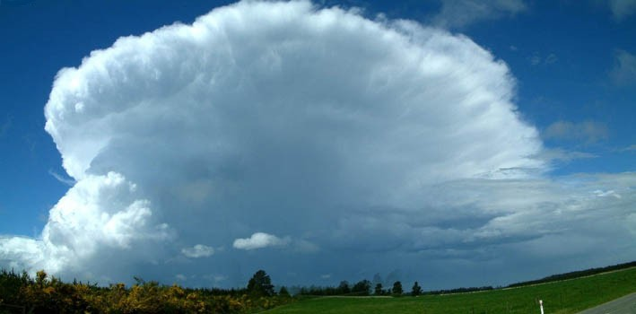
C O N F I D E N T I A L C O N F I D E N T I A L C O N F I D E N T I A L C O N F I D E N T I A L C O N F I D E N T I A L C O N F I D E N T I A L

Slide 2
SYSTEM FOR WEATHER MODIFICATION

Slide 3
Is it possible to influence on weather?
Hail
Snow
Rain
YES!!!!!

Slide 4
Way of influence
Stimulation
Suppression
Using
Aircraft – especially equipped
Rocket system – original design

Slide 5
Essential parameters:
Price of Technology
Not expensive rockets
Efficiency reagent, reliable, new
Friendly system for use
Mobility
Compatibility – other systems

Slide 6
Monitoring system
Main elements in use
Meteorological Satellites:
Polar Orbit – 12 h cycle
Geostationary – with earth

Slide 7
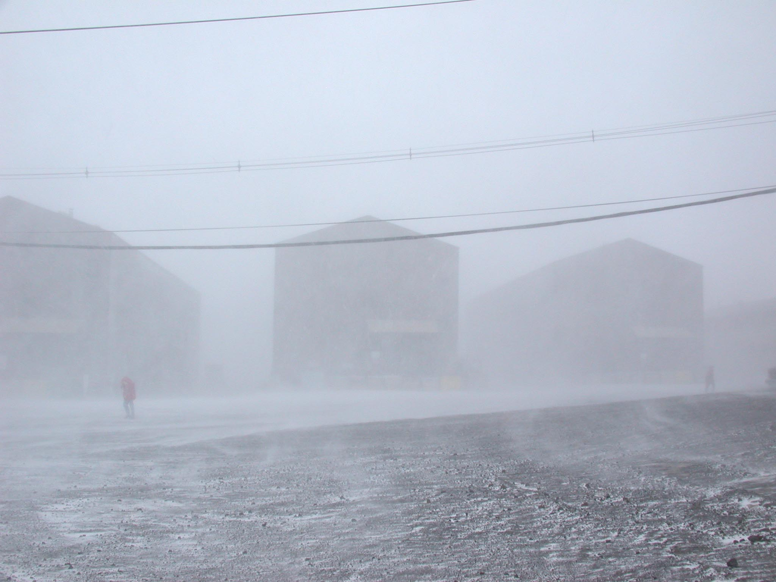
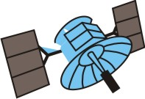
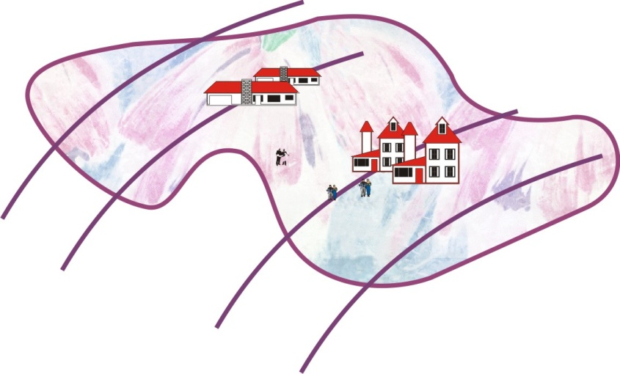
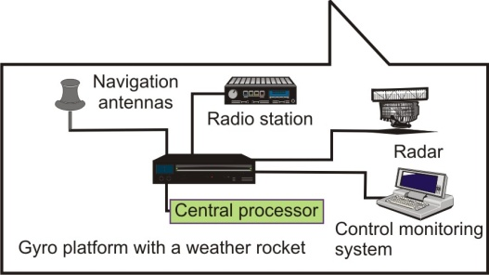
Monitoring system in operation:
Rescue
Direction
SEARCH & RESCUE
OPERATION
MISION
CONTROL
ELEMENTS (MCE)
OTHER
INFORMATION
SOURCES
Other sensors
Historical
Cartography. Gis
Other intelligence
IMAGE PROCESSING:
Image Formation
Data Fusion
Image Analysis
Further Extraction
Interpretation
Assessment
Broadcast
Communication
Two way
Communication
DIRECTED RELIEF
EFFORTS
DISASTER RELIED
COORDINATION
CENTER
OTHER INFORMATION
SOURCE
News Services
Metrological Report
Other Government Depart.
Other Emergency Situation
Situation Status
Information
Coordination
Radar
Coordination
Coordination
PROVINCIAL
EMERGENCY
MEASURES
OFFICE
FEDERAL
GOVERNMENT
EMERGENCY
PREPARADNESS
MONITORING (DISASTER)
COMMAND CONTROL CENTER
Situation Status
Information
Situation Status
Information
Other provinces
News Media

Slide 8
System consist:
Meteo Satellite (Met/Sat)
Ground Control Station (GCS)
Central Meteo Station (CMS)
Local Meteo Station (LMS)
Movable Portable Station (MPS)
Data & Link Communication (D&LC)
Telemetry System Design (TSD)
Command Control Center (CCC)
Battery Command Post (BCP)
Rocket System Conceptual Design (RSCD)
Transport & Launching Conceptual Design (T&LCD)

Slide 9
ROCKET SYSTEM
HYDRA - rocket system consist:
Rockets - suppression, stimulation
Transport - launching container
Launching ramp
Starting device
Control monitoring system

Slide 10
IMPORTANT………
Mobility, flexibility

Slide 11
HYDRA consist six substructures:
Stabilizer carrier & stabilizers
Nozzle with rocket destruction system
Rocket propellant grain
Rocket motor chamber
Forward closure of rocket motor
Rocket head with reagent

Slide 13
Important:
1 Flame carrier
2 Chamber with reagent
3 Detonator
4 Nosecone
super active reagent
silver iodide
carbon dioxide, dry ice
nitrogen liquid,
ice crystals

Slide 14
Technology - Rocket Propellant
PREAMBLE REMARKS………………
Result of many years of research of multidisciplinary team, with great
experience in creation of the real production systems.
Is based on application of oxidizer uniformly dispersed in a continuous
matrix of thermoplastic elastomer binders, on different polymers.
In production different manufacturing could be used:
processes
pressing,
calendaring,
fusion,
extrusion.
Manufacturing of grains can be performed in an automatic way,
programming in various phases, always in way to get optimum result.

Slide 15
THE CHOICE
Technology is considerably distinct from the conventional methods, & has
many advantages in comparison with them.
The equipment, raw materials are standard one - used in
Chemical industry,
Easily from the open market,
No restriction.
Each raw material can be ordered from different suppliers, same properties.
Important:
Technology is superior compared to the other existing.
Application field wider than other class of solid
propellants.

Slide 16
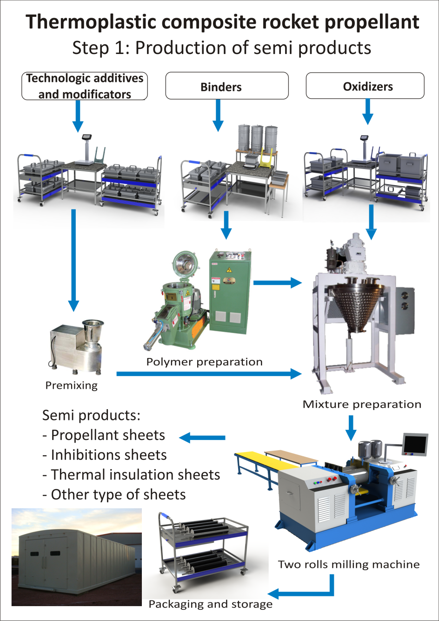
TECHNOLOGICAL ACCESS
The rocket propellant grain
is made in:
II independent phases.
I First phase (semi-product)
In this phase all ingredients are weighed
& mixed, and then the blend is sheeting
(calendaring) on the two-roll mill,
where is gelatinized &
transformed into a stripe or granule form.

Slide 17
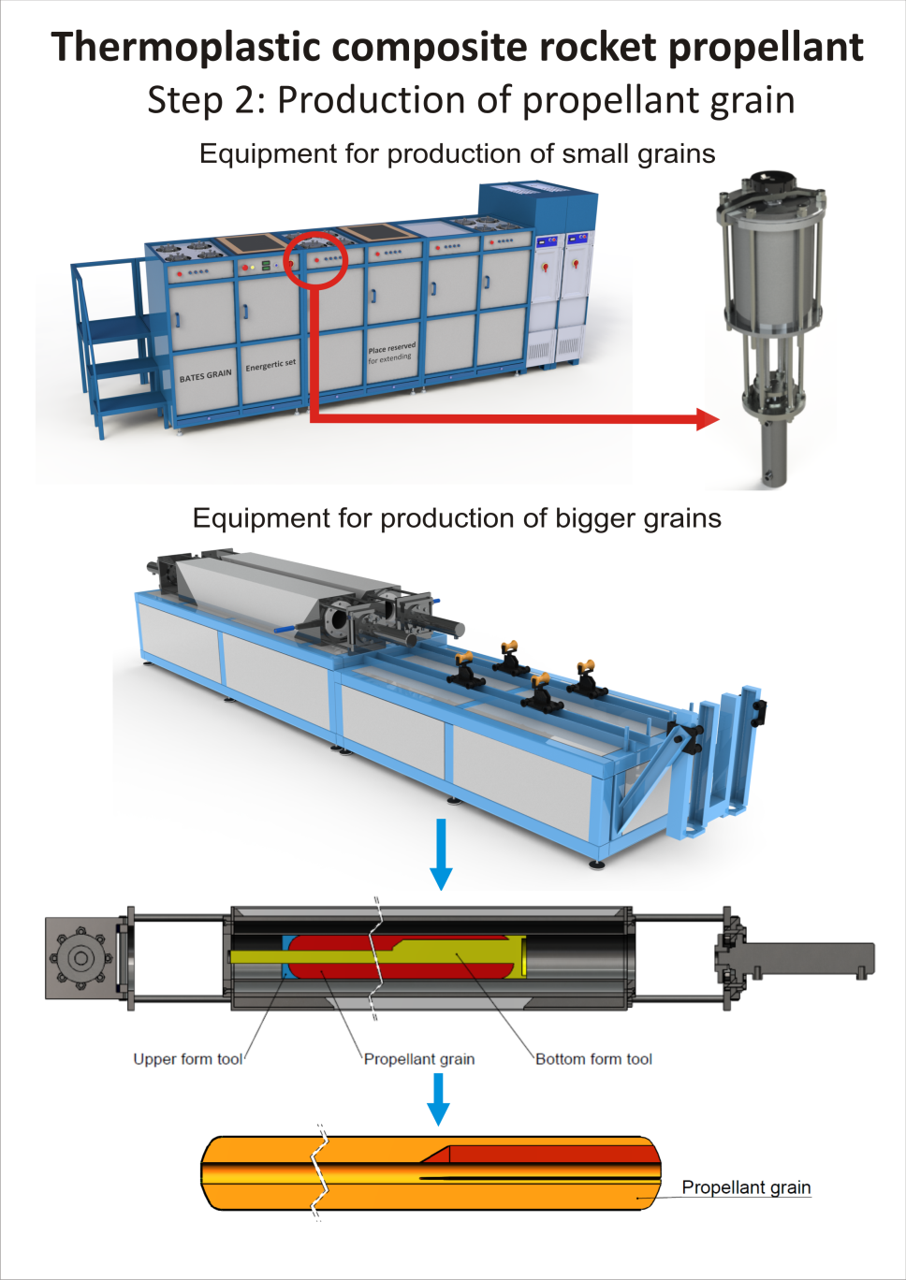
II Second phase
The feed, which is formed from number
of carpet rolls stacked one next
to the other, is put into TEPVAC plant,
where is integrated in a grain
under desired time, temperature & pressure conditions.
Important:
Machinery & equipment, used now days for conventional thermoplastic & PVC processing, can be used in our technology after proper Modification.

Slide 18
RAW MATERIALS
Standard oxidisers (ammonium perhlorat are used in our
composition, although other solids can be also applied.
Binder - composed from standard polymers or special block copolymers.
They are created in the dependence of specific requirements for propellant,
& we can adjust the technological process for specific binder.
Additives & modifiers are used in dependence of specific
requirements, to assure that the composition should achieve desired
properties larger quantity of aluminium or other matters, not possible in the
Necessary to check quality of the outcome results, & to see if exist some
external factors which can influence on our product or process.
classical processes.

Slide 19
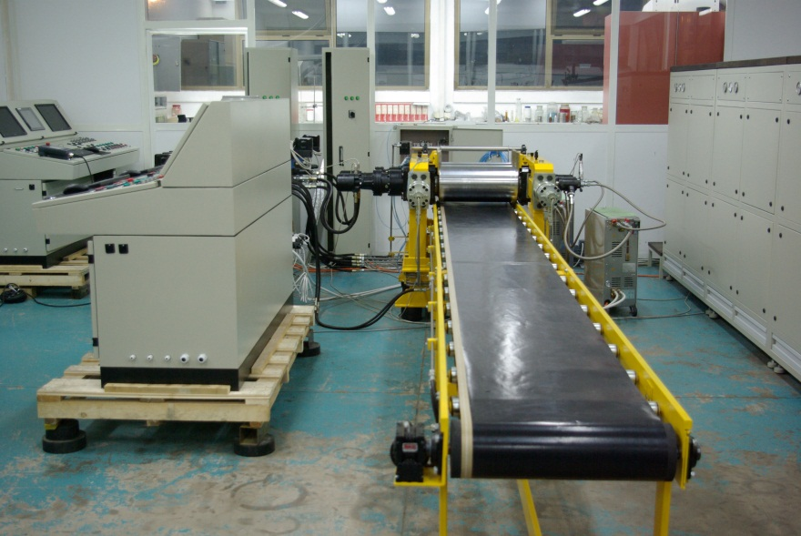
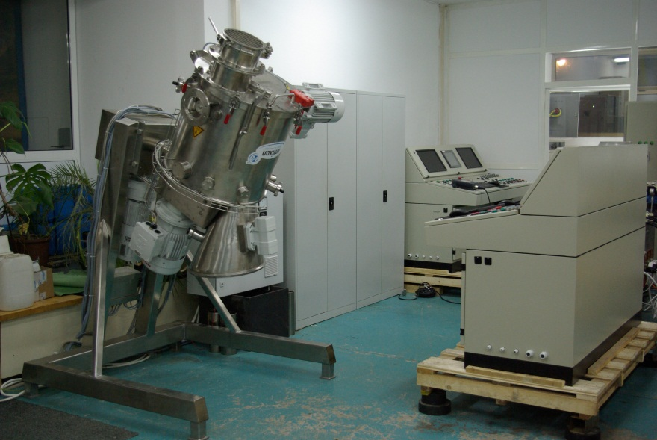
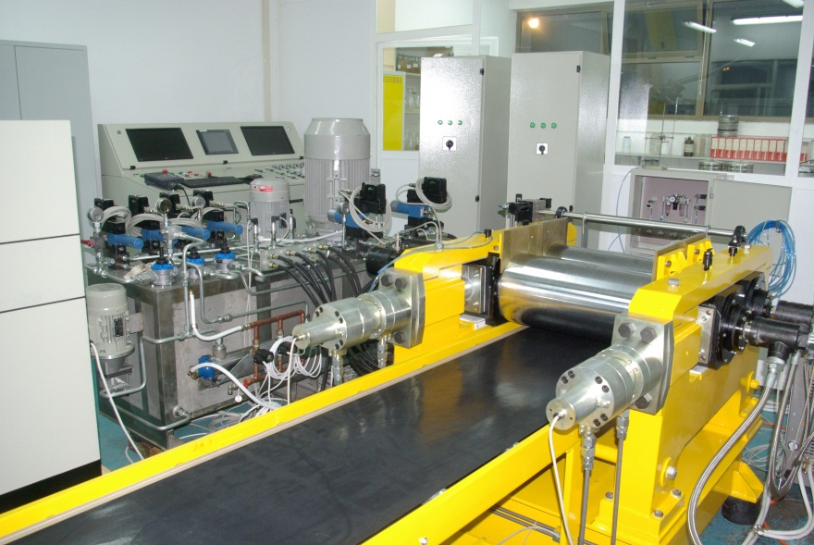
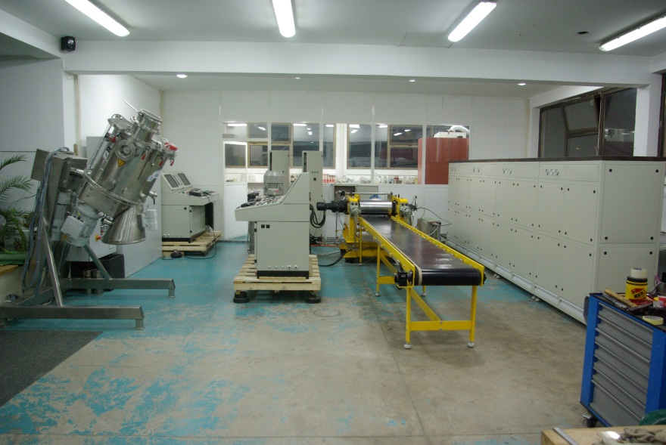
IMPORTANT….
All necessary machinery & equipment
are designed & composed from the
equipment (spare parts) which are found
easily in the market.
“KNOW- HOW” will be available for the
future, until the Customer achieves full
independence.

Slide 20
WHY DO WE THINK THAT OUR TECHNOLOGY WOULD BE INTERESTING FOR YOU?
Knowledge achieved at the base of great experience our technology
drives us to realise the advantages in comparison with others, the
main of which are the following:
Price of technology
Advantages of technology process
Considerably low price because:
standard equipment and machinery are used
special equipment which helps one to work without our assistance and its components, can be easily found in any market.
raw materials are standard & may be easily identified in the market

Slide 21
IMPORTANT………
Advantages of technology process
Thermoplastic binder, low cost ingredients, commercially available, thus yielding economical products.
The technological process is accomplished through salvation or “physical curing“, with thermoset binders we have polymerization reactions in which prepolymers are cross-linked by chemical curing agents, so-called "post-cure“.
The use of thermoplastic elastomers instead of cross-linked elastomers avoids the problems associated with pot-life and cure time.
The thermoplastic binder systems & their ingredients are almost insensitive to moisture & impurities in other ingredients.
Manufacturing method allows that dry or wet blend may be prepared at a remote location.

Slide 22
After calendaring, storage life of sheet (semi-product) is unlimited, no changes in the main characteristics.
As a stable semi-product, the sheet can be immediately used after delivery to the end user at close or distant locations in various forms.
In vacuum casting of large, cross-linked solid rocket motors, a high propellant level rise rate is required. In the process with thermoplastic elastomers, rise rate is not in a consideration.
During cure of cross-linked elastomers, the mixture will shrink, which can cause a tensile/shear stress across the bond area, thus creating a problem that often leads in bond failure to the rocket insulation & casing, and causes propellant cracking - Our process enhances propellant integrity because significantly eliminates the stress induced propensity for surface cracking.
Thermoplastic propellant grain can be recycled as opposed to cross-linked propellant grains.

Slide 23
Defects of thermoplastic propellant grains may be corrected by melting localized portions of the grain or reprocessing.
With thermoplastic elastomer propellant formulations, the process can be interrupted at any stage; even interfaces which are produced by interruption of fusion can be corrected by re-melting the grain at any such interface.
Casting of a cross-linked propellant grain cannot be interrupted for even short periods of time, or discontinuous interfaces will result in the propellant grain.
Energy required to melt the thermoplastic elastomer is less than that required to cure or cross-link a chemically active thermoset propellant. Fusion temperature of the thermoplastic elastomer propellant formulation may be higher than typical cure temperatures of cross-linked elastomers, the time required for fusion is subsequently less than time required for curing (φ135=6days/8h).

Slide 24
The processing equipment is standard one, no additional costs & without any embargo. The need for high–shear mixers or extruders is eliminated.
The process can be completely automatized, with little manpower during the process of manufacturing propellant sheet and its processing into grain.
The pressure level & the achieved forces during the propellant grain manufacturing are low, contributing to the safety of the production procedure.
No limitations in minimal or maximal outside diameter of the produced grains.
Process allows tailoring of a variable burning rates & also superior quality control of the manufactured propellant before it is produced in the form grain or joined with the rocket motor casing.

Slide 25
Fusion of different compositions of propellant is possible with various energy & ballistic properties into a unique grain, leading to easy & flexible production of single-chamber dual thrust propellant grain. This tailoring facilitates the provision for optimum thrust versus time performances.
The inhibition process is a part of the grain manufacturing operation. Excellent bondage between inhibition and propellant is obtained after completion of this process.
Method improved integration of small metal & non-metal parts for connecting the grain to motor elements, and integration of a large number of metallic heat conductive wires to increase the burning rate.
Proper grain dimensions can be easily achieved by additional machining, owing to good mechanical properties of propellant.
Quality control is facilitated than for conventional propellants.
The full characterization is possible in all phases of manufacturing process, prior to grain joining with the rocket motor casing.

Slide 26
COMPARISON BETWEEN CLASSES OF COMPOSITE PROPELLANTS
The characteristics of rocket propellants with the same energy properties, produced by the classic casting method & produce by our technology, are listed in the following table.
CARACTERISTICS | THERMOSET COMPOSITE PROPELLANTS (HTPB) | THERMOPLASTIC COMPOSITE PROPELANT
Specific impulse (Ns/kg) at pressure 70 bar | 2600 | 2600
Density (kg/m³) | 1740 | 1800
Linear burning rate (mm/s) at pressure p=70 bar | 2 – 40 | 5 - 70
Exponent in linear burning rate law | 0,2 - 0,7 | 0,1 - 0,6
Minimal pressure of stable burning (bar) | 5 | 1
Tensile strength (MPa) at +15 C | 0.8 - 1.2 | 1.2 - 3.6
Maximum strain at break (%) | 30 - 80 | 2 - 20

Slide 27
Temperature range (ºC) | -50 - +50 | -50 - +65
Raw propellant physical state | Viscous paste | Sheet, grains
Raw propellant stocking time | 30 min | > 10 years
Manufacturing process of grain | casting | Pressing, injection, extrusion
Possibility for integration of the metallic heat conductive wire | Poor (none) | Good
Capability for machining | Poor (none) | Good
Inhibition | satisfactory | excellent
Metal powder integration capability (%) | 20 | 50
Possibility for integration metal parts for connection or control | none | Good
Grain maximum mass (kg) | < 100,000. | < 50,000.
Maximum grain diameter (mm) | 7,000. | 2,000.
Type of equipment for technological process | Special, restrictive | Standard and modified
Ability for purchasing of the raw materials | Restrictive, special approval | Commercial raw material
Ability for production of unique grain with different compositions of propellants | no | yes
Possibility of recycling | no | yes

Slide 28
IMPORTANT………
Subject of proper integration

Slide 29
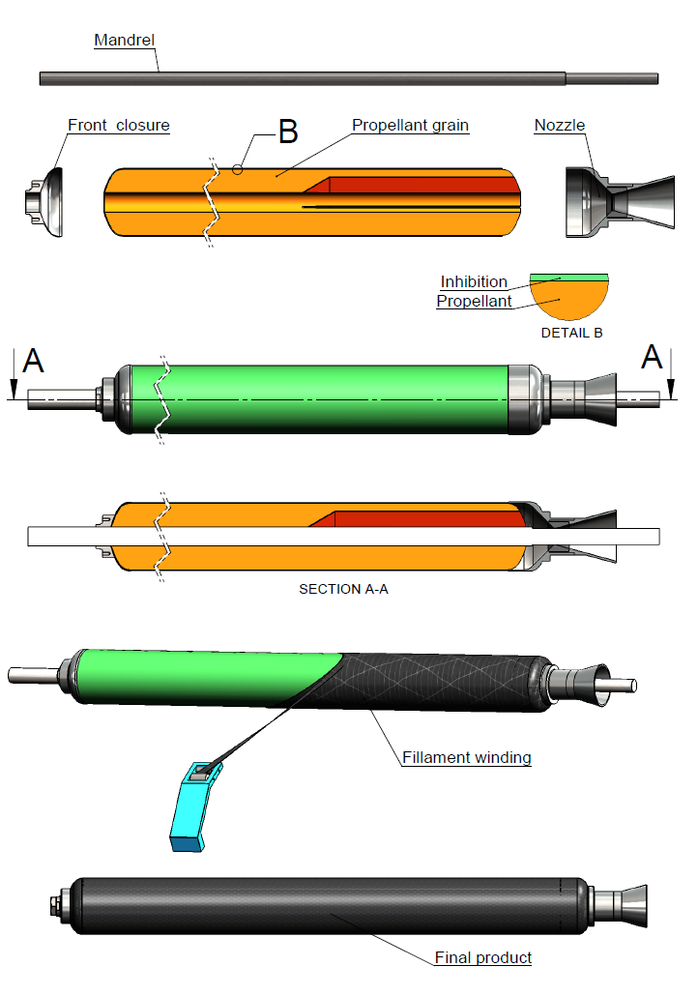
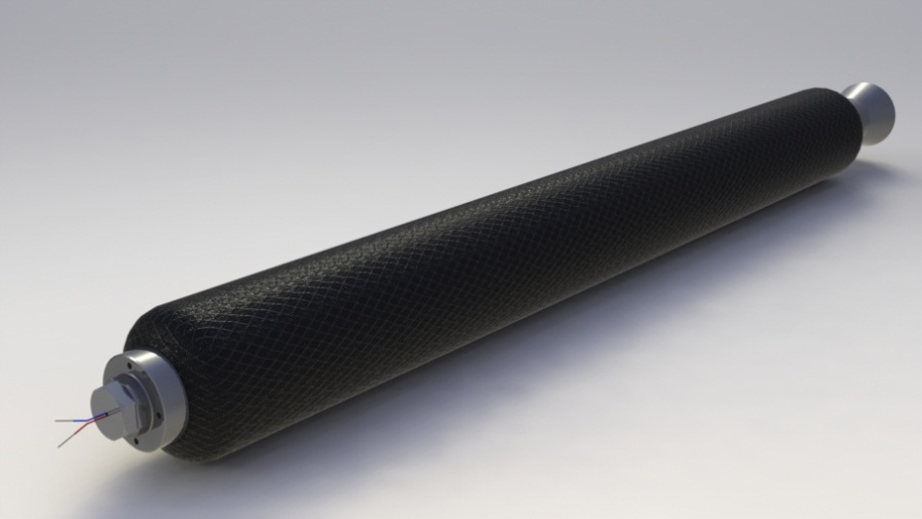
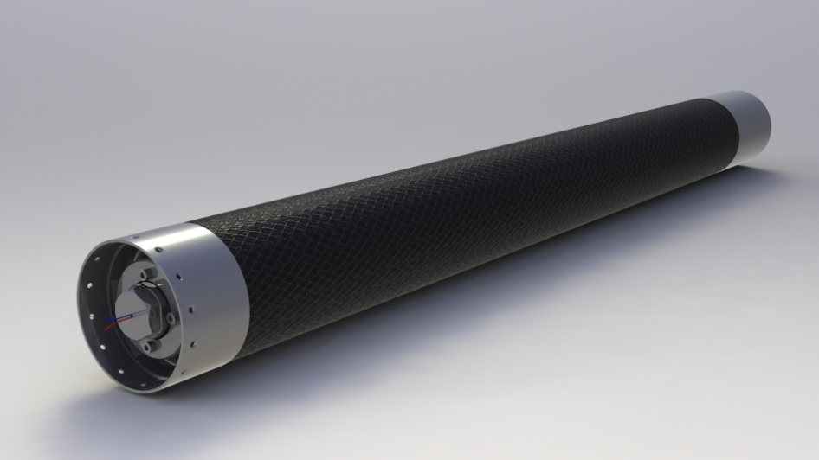
CASE-BONDED GRAIN

Slide 30
Strategic advantages
The offered technology makes possible:
Substitution of grains in existing rocket systems which resources had expired or are about to be exhausted, by others which easily may be produced in your facilities in order to expand the life of the existing systems and so on.
Design of own systems from scratch.
Elimination of Influence & restriction from “abroad”.
Providing Services to countries with good relationship in order to get strategic and economical benefits.
& last but not the least the Independence with which you can operate.

Slide 31
Abilities for the initial capacity
The areas, which will be covered, depend on and are in accordance with the strategy of
the state for modernization & expansion of its armed forces, & also will be in
accordance with the internal and world-wide market needs for this type of production.
We may suggest conquering for new products:
Production of Multiple Launcher Rocket System (MLRS). The range of the system will be defined additionally in the range from 3-7 to 20 km.
Production of Anti-tank remote control missile, for which we can also propose specifically developed construction of the system
Production of MLRS system with range to 60 km, & more then 150 km.
Production of rocket grains for substitution in the existing rocket systems (renewal of the rocket motors) no matter of origin to which system belong (eastern or western countries, like MAGIC, TOW, EXOCET, NEVA, KUB, SA-2, BM-21, K-13, MALUTKA, KORNET, BASTION…all types based on the solid rocket propellants).
Development of independent middle & long range systems.

Slide 32
Development of technology & production program
Together with undertaking the production of thermoplastic propellants by
your side, we shall transfer to you the following instructions materials:
Complete technological-technical documentation for standard & special machinery equipment with all necessary steps of processing.
Complete set of softwares with appropriate manuals which cover wide aspects related to rocket technology, which are using in the technology processes, as well as for the training of your personnel.
Complete training through special courses and seminars by our experts which would be held at your factory, in order to educate workers to become ready to “put on” the processing program.
Our team of experts will always be on your disposal in solving problems during works.
We shall be on your disposal for future development of the new products.

Slide 33
Civilian program, personnel training & education
Products can be applied in civilian programs like:
Fire extinguish system based on composite solid propellants (SPFE). Most efficient system that existing today.
Air beg system using our technology for inflator production.
Personnel training Issuance of booklets & other relevant leaflets for personnel training & education’s in respect of using the system technology and the products.
System for surfacing all sinking objects (ships, submarines), special developed gas generators.
System for floating ships or other passengers carrying vessels in case of an accident or crash.
Production of variety of high quality plastic foils.

Slide 34
Final variety products

Slide 36
Conclusion
Technology has many advantages in comparison with other existing
Technology based on thermoplastic elastomer (TPE), binder system makes possible use of various types of non-standard methods (processes) in manufacturing of rocket grains & its assembling in rocket motors
Technology was realized independently, no restriction, embargo for any material or equipment required
Great experience in creating & building the new factory & new products,
Complete grains, i.e. propellant + inhibitor +bonding elements, can be produces in the same process.
Technology can be base for developing other products, which can be applied in civilian programs,
Technology can be operative in all difficult circumstances,
Developed of the new program are not restricted & does not depend on any other external subjects.
Due to the good mechanical properties of the integrated grain, it can be used as a mandrel for the production of motor cases from composite materials (case-bond grains).
Green Technology – due to global reduction of the waist & pollution prevention, it belongs to the clean manufacturing processes.

Slide 37
THANK YOU
For anyone who is looking in
our direction, could be of help to
us, as well as for his part of
environment, which could be
developed based on free
decision.

